Slide 1


Proclaim
Tsotne Bukiya
Eoin Burton

Slide 2
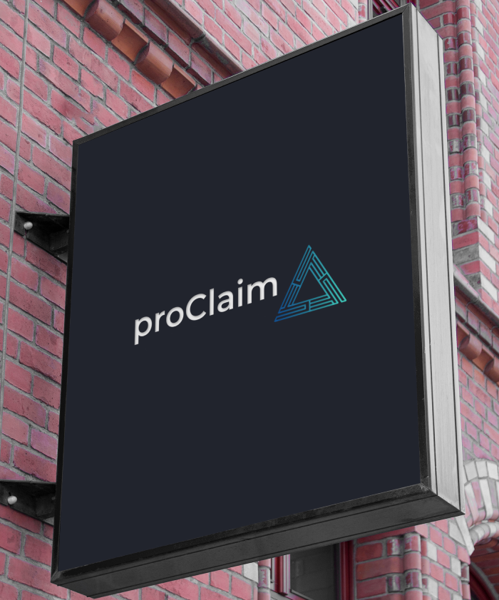



Problem Statement
There is a growing demand from institutional clients and custodians for proactive and real-time resolution of post-settlement claims in the Securities Services space.
The current market infrastructure, transactional risk and operational burdens do not facilitate timely and efficient clearance of claims requiring bilateral agreement between counterparties.
≈ $10BN
≈ 200,000
≈ $9MM
Total Value
Total Claims
Operational Cost
Securities Lending Claims account for 90% of the total value.
Processed across more than a dozen teams globally, comprising up to 85 employees, these claims surpass 200,000 annually
The non-standardized nature of the process and increasing volumes contribute to high operational costs.

Slide 3
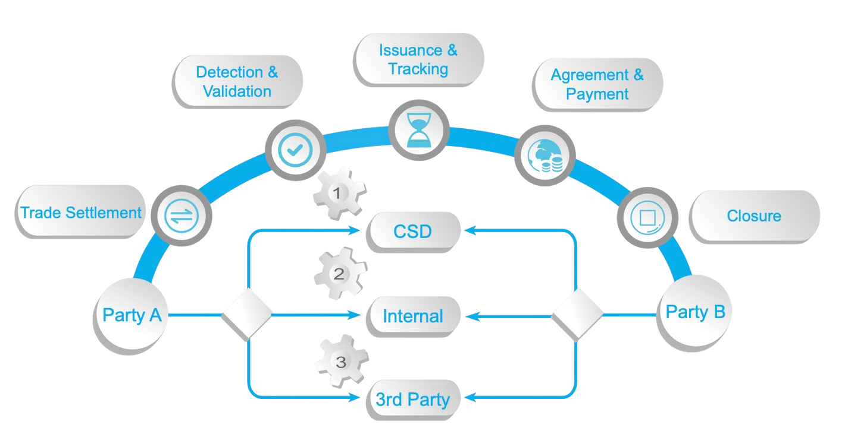
As Is Process
Auto-Settle Rate
% 40
CSDs offer Auto-Settlement services to custodians, but due to market infrastructure and other factors, less than half of these transactions are auto-settled.
FTE Count
84
Different teams handle cases based on claim type, product, and market. The processes of issuance, claiming, tracking, reconciliation, and payment lead to delays and high overhead costs.
Counterparties
200+
Existing 3rd party solutions focus on specific sub-sets and markets but are not widely used by the over 200 counterparties Citi Custody routinely interacts with.

Slide 4




Market Insight
It seems to take weeks, months for resolution on items we raise ... pretty vanilla claims take 30+ days to resolve.
NAB simply can’t believe that two organizations the size of Citi and JP Morgan cannot resolve this.
The lack of standardization or one global solution needs to be raised
as a priority.
We estimate the annual cost of managing coupon and dividend claims alone exceeds US$ 150 million.

Slide 5
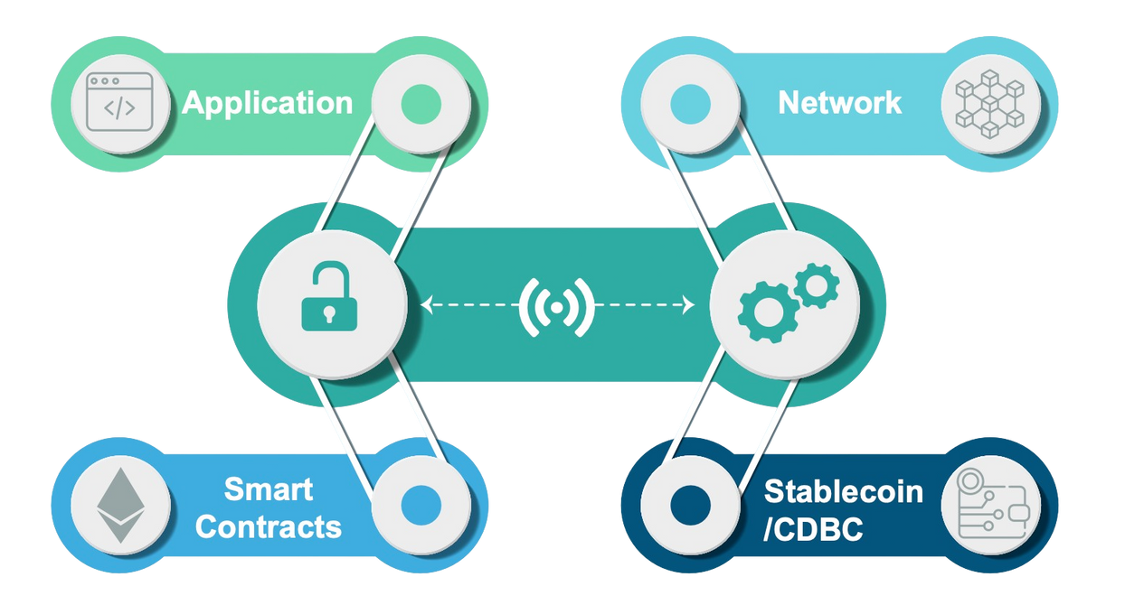
Introducing proClaim
proClaim: a blockchain based platform, powered by a decentralized network and smart contracts, with the potential to secure an almost 100% STP claim se
proClaim uses smart contracts on a permissioned network to match and settle uploaded claim records. Once validated, transactions are settled using an in-house stablecoin, providing full auditability on the blockchain.
The whole cycle of post-settlement claims comes down to minutes, completely reengineering and standardizing the claims process across the entire ecosystem.

Slide 6
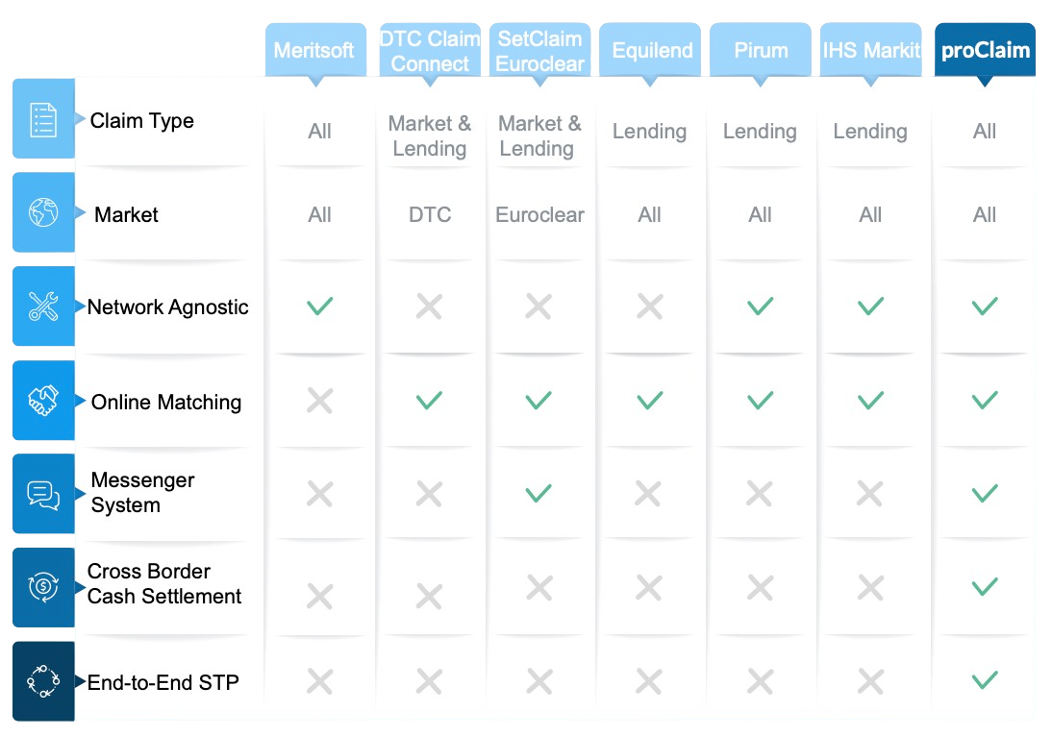

Slide 7
proClaim Benefits
Vendor Fees
$ 1.5MM
FTE Save
$ 2.1MM
Currently in talks with different vendors, Citi has been exploring solutions. By choosing proClaim, Citi would avoid costs incurred by market vendors
proClaims’s disruptive approach to claims automation will enable up to a 60% FTE reduction:.
Sunk Cost
$ 1.5MM
$ 0.5MM
Transaction Fees
At any point in time Citi is carrying up to $180M in breaks in accounts receivable. With a mere 0.79% annual yield rate of a 5 year US Treasury Bond, Citi is incurring an opportunity cost, which proClaim will eliminate.
Tokenized cash on the blockchain eradicates costs associated with transaction fees.

Slide 8

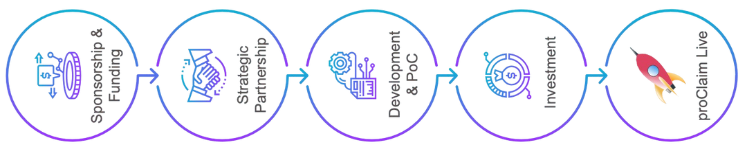

Next Steps
In our initial roadmap for proClaim, we outlined five key steps: Sponsorship & Funding, Strategic Partnership, Development & Proof of Concept (PoC), Investment, and finally, proClaim Live.
However. this year we decided to bypass the first two steps and we focused on direct development. The Proof of Concept (PoC) for proClaim has already been built and deployed.
The next phase will involve testing the platform with Citi Blockchain and the Citi USD Token, both of which are already developed within Citi. This testing will enable us to validate the PoC with real-life data and applications, ensuring that the platform is ready for broader implementation and further investment.

Slide 9
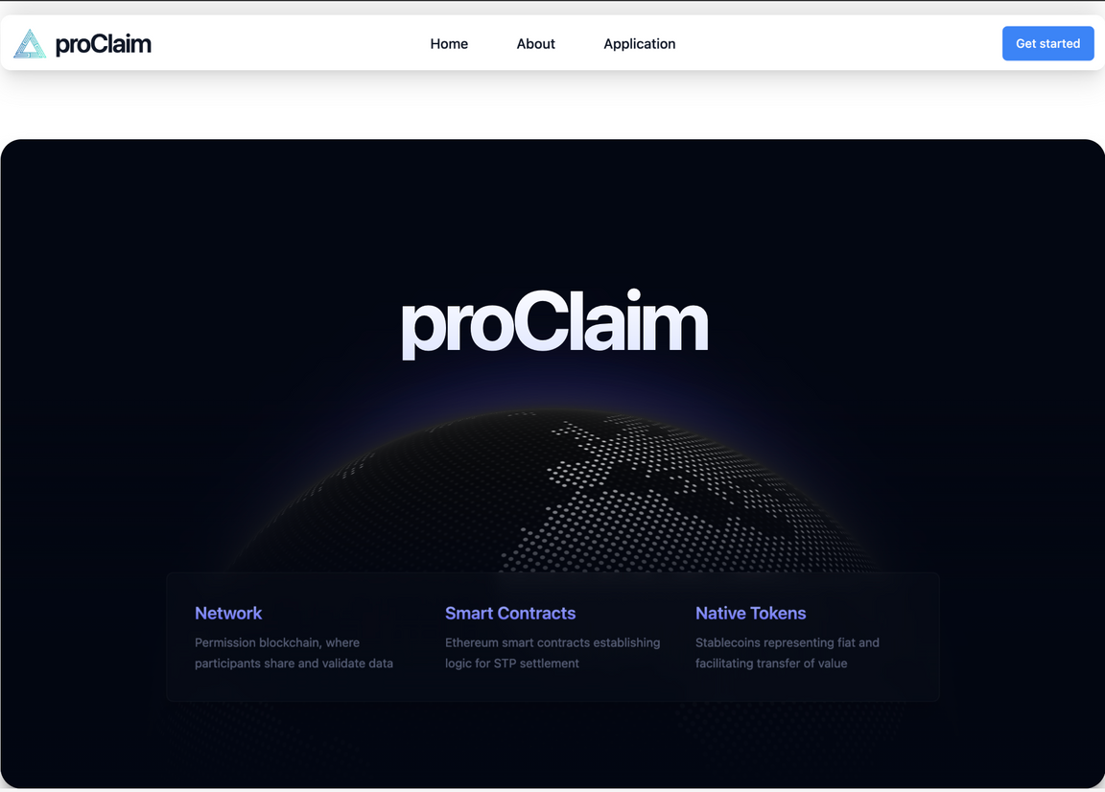
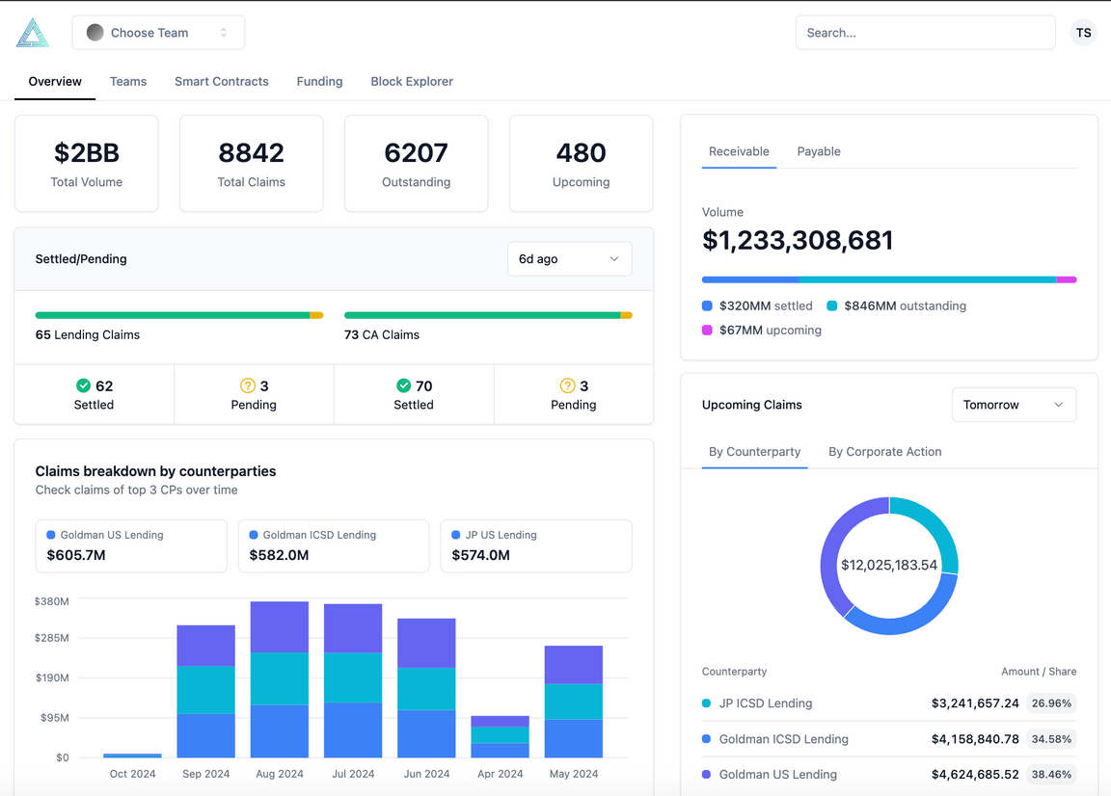
Proof Of Concept
Internet of Things Tools
Smart Home Platform

Slide 10
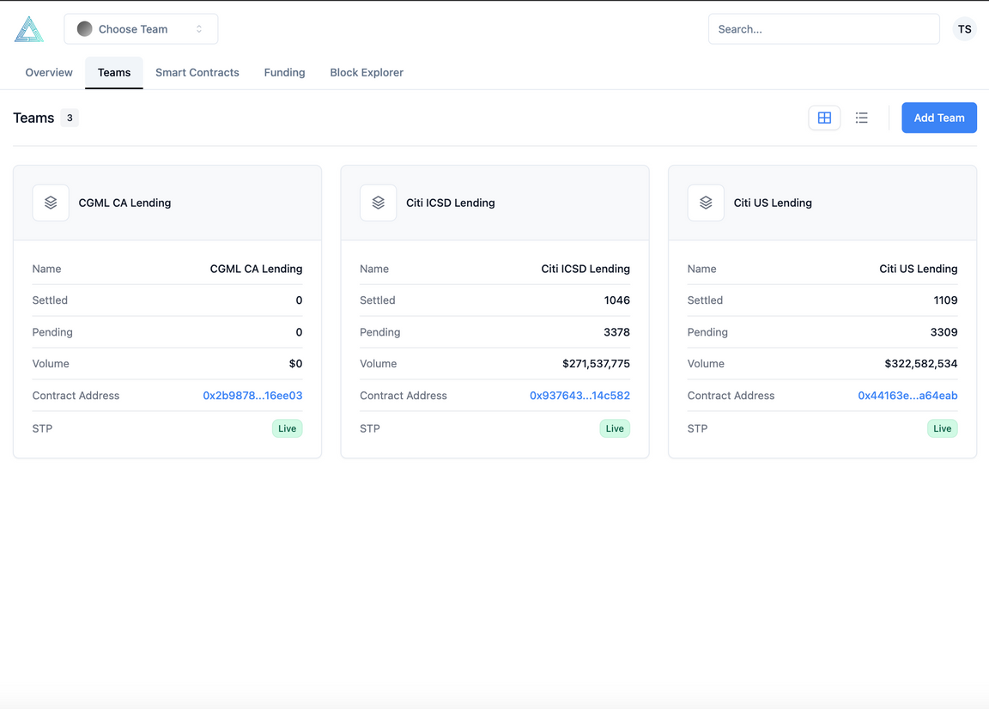
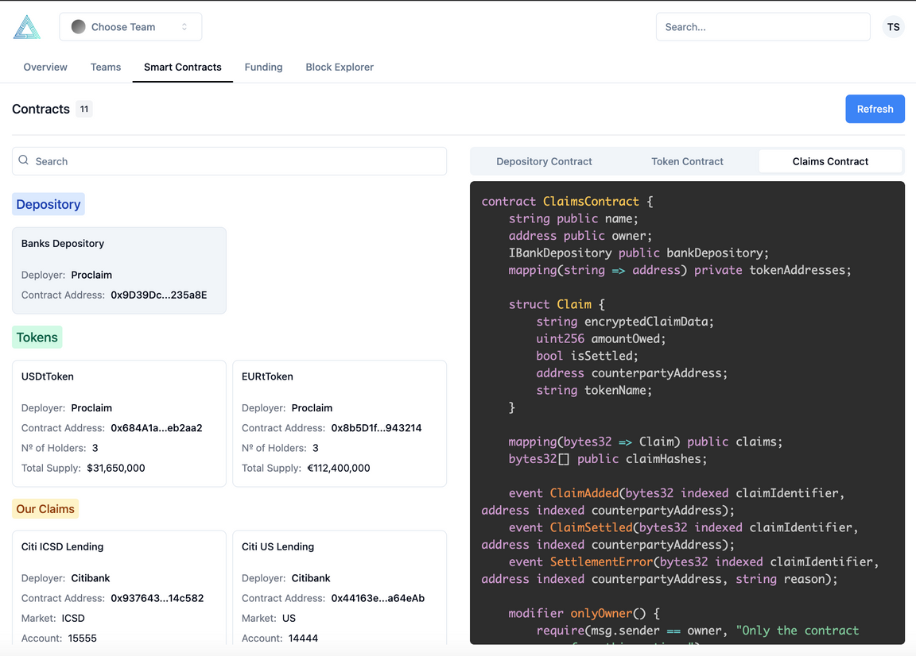
Proof Of Concept
Internet of Things Tools

Slide 11
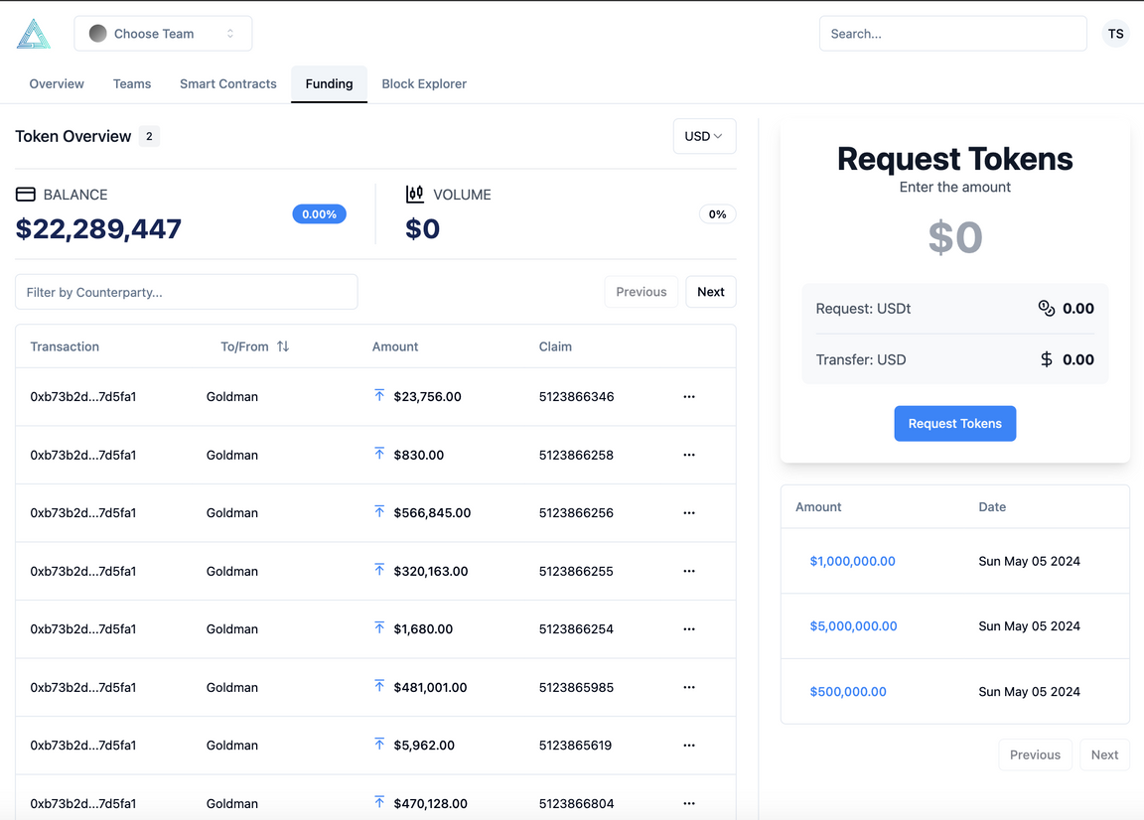
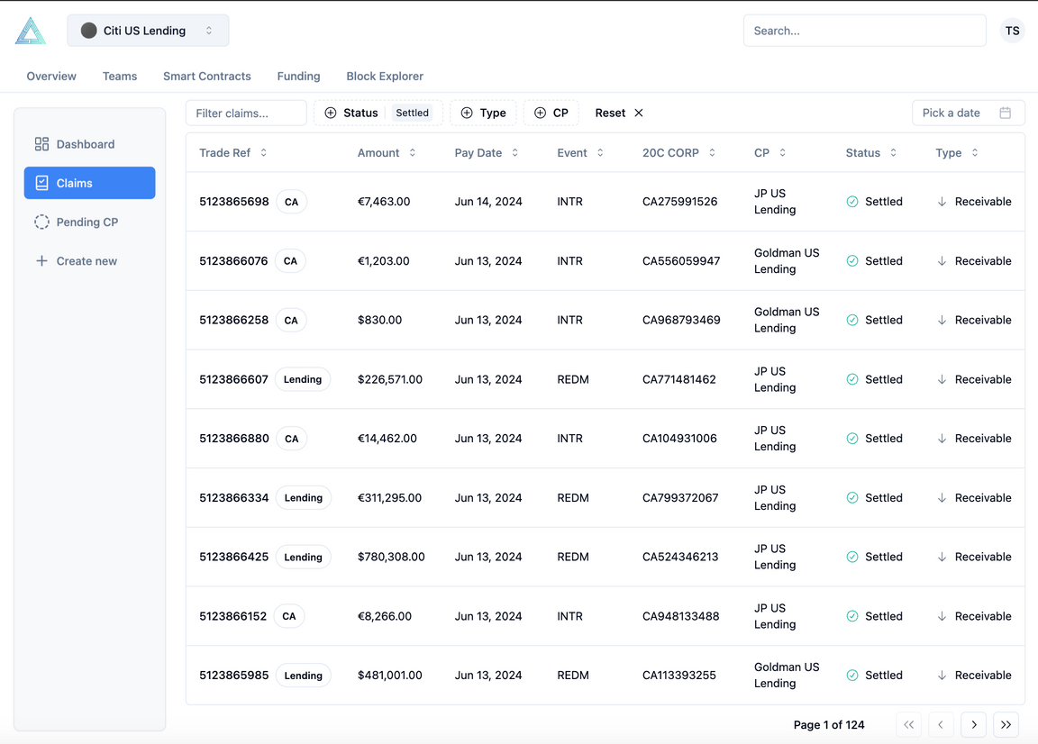
Proof Of Concept
Internet of Things Tools
Smart Home Platform
The product category that
we serve as an alternative is
offered. However, what we
offer must relate to one
another in solving society
and market problems.

Slide 12
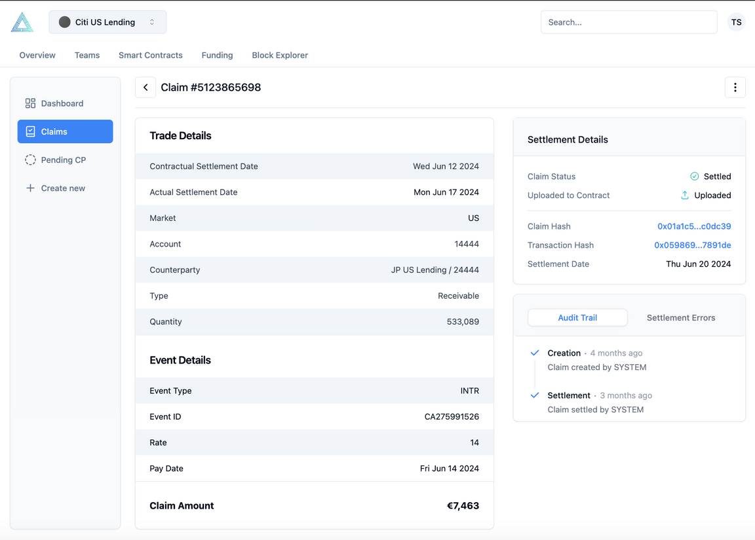
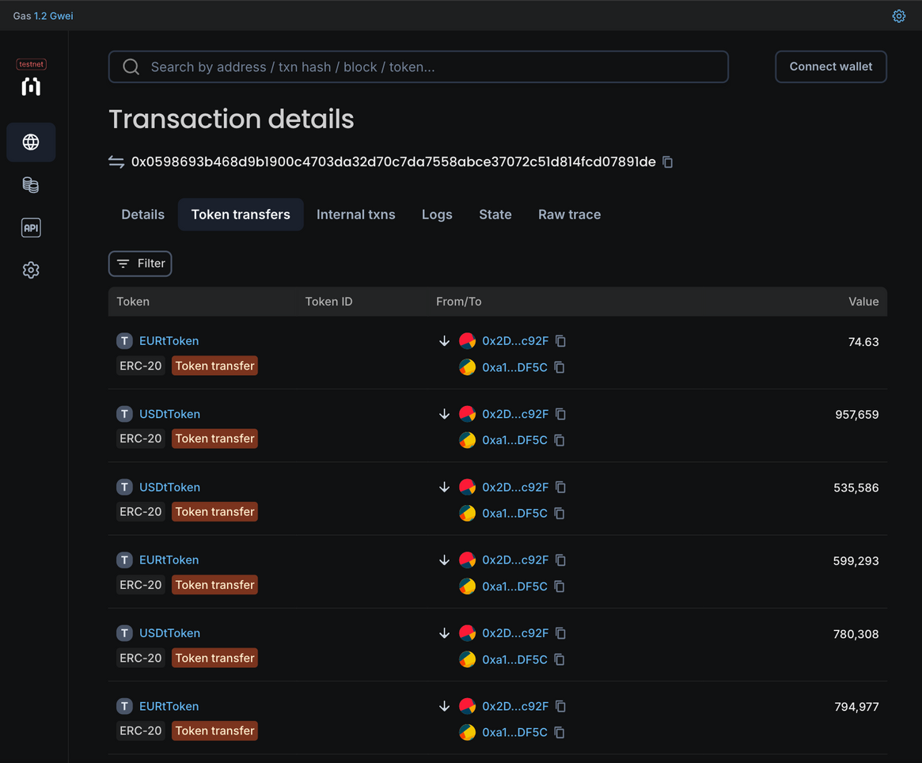
Proof Of Concept
Internet of Things Tools
Smart Home Platform

Slide 13
Thank You

